Slide 1
Welcome FY24 EiC Cohort!
Early In Career Learning Curriculum
Vanessa Anderson, Senior Cloud Solution Architect

Slide 2
Agenda
Introduction
What is Azure?
Intro to Azure Core Concepts
Azure Governance
Azure Networking
Azure Security
Azure Governance
Protect Azure

Slide 3


Slide 4
What is Azure?
Azure is Microsoft’s cloud computing platform with an expansive set of services that allows you to build solutions to meet your business needs.
Announced In 2008 and became live in 2010
Has now grown to over 200 services.
Operates in multiple regions
1 billion per year in security investment
95% of the fortune 500 are on Microsoft Azure

Slide 5
Cloud Models
The cloud models define the deployment type of cloud resources.
The three main cloud models are: Private, Public, and Hybrid.
A fourth, and increasingly popular cloud model is Multi-Cloud.
In a Multi-Cloud environment, you use multiple public cloud providers and manage the security and resources in the respective cloud environments.
Notes:
Examples of private cloud: HPE, Dell, Vmware(2 types), IBM, Oracle
Examples of public cloud: Azure, AWS, and GCP

Slide 6
Question 1
Which cloud model provides the greatest degree of flexibility?
Public
Private
Hybrid
Notes:
Answers
Question 2: Hybrid cloud model provides the greatest degree of flexibility, as you have the option to choose either public or private depending on your requirements.

Slide 7
Infrastructure as a Service
Provides customer the maximum amount of control for your cloud resources.
The cloud provider is responsible for maintaining the hardware, network connectivity (to the internet), and physical security.
You’re responsible for everything else: operating system installation, configuration, and maintenance; network configuration; database and storage configuration, etc.
IaaS may be a suitable option for lift-and-shift migration to Azure.

Slide 8
Platform as a Service
The cloud provider maintains the physical infrastructure, physical security, and connection to the internet.
You don't have to worry about the licensing or patching for operating systems and databases.
PaaS is well suited to provide a complete development environment without the headache of maintaining all the development infrastructure.
Cloud features such as scalability, high-availability, and multi-tenant capability are included.

Slide 9
Software as a Service
The most responsibility is with the cloud provider and the least responsibility with the Customer.
Customer is responsible for the data that you put into the system, the devices that connect to the system, and user access.
The cloud provider is responsible for physical security of the datacenters, power, network connectivity, and application development and patching.
Some common scenarios for SaaS are email and messaging, business productivity applications, and finance and expense tracking.

Slide 10
Shared Responsibility in the Cloud
In a traditional datacenter the IT department is responsible for maintaining all the infrastructure and software needed to keep the datacenter up and running.
In cloud computing, those responsibilities shift to the shared responsibility model.
The shared responsibility model spans across the three cloud service types: Infrastructure as a service (IaaS), Platform as a service (PaaS), and Software as a service (SaaS).
Notes:
Key Point
You’ll always be responsible for:
The information and data stored in the cloud
Devices that are allowed to connect to your cloud (cell phones, computers, and so on)
The accounts and identities of the people, services, and devices within your organization
The cloud provider is always responsible for:
The physical datacenter
The physical network
The physical hosts
Your service model will determine responsibility for things like:
Operating systems
Network controls
Applications
Identity and infrastructure

Slide 11
Question 2
You need to run two types of applications–legacy applications that require specialized mainframe hardware and newer applications that can run on commodity hardware.
Which cloud deployment model would be best for you?
Public
Private
Hybrid
Notes:
Answers
Question 3: Hybrid cloud model would enable you to run your legacy application requiring custom configuration and direct management on your private cloud allowing you more control, and the more modern applications on the cloud platform gaining the benefits of the public cloud model.

Slide 12

Geographies
Defined by geo-political boundaries or country borders
Defines the data residency boundary for customer data
Geographies:
Americas
Europe
Asia Pacific
Middle East
Africa
Notes:
A list of geography locations is available on the page https://azure.microsoft.com/en-us/global-infrastructure/geographies/

Slide 13
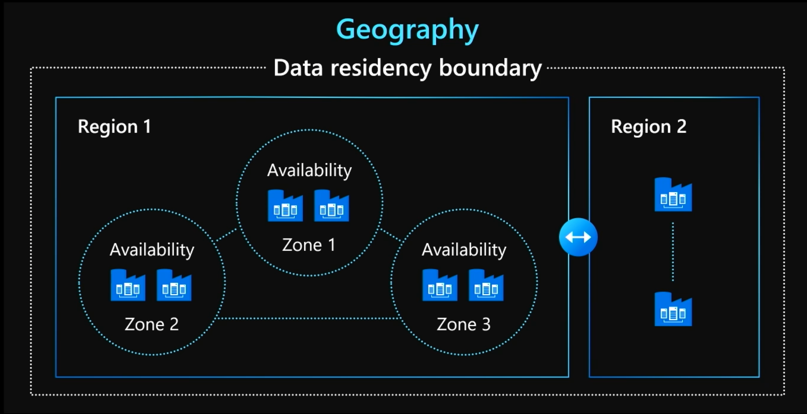
Azure Regions
Region
Within each region, multiple datacenters exist to
provide for redundancy and availability
Region Pairs
Each Azure region is paired with another region
within the same geography (such as US, Europe,
or Asia).
One region is prioritized out of every pair
Planned Azure updates are rolled out to paired
regions one at a time to minimize downtime and
risk of application outage.

Slide 14
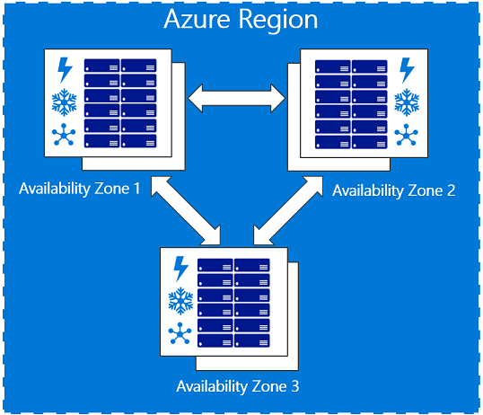
Availability Zones
Protect against datacenter-level failures
3 separate zones within each supported region
Independent power source, networking and cooling
Available in Supported Regions
Notes:
KEY TAKEAWAYS
Recap
Availability Zones help to protect you from datacenter-level failures. They are located inside an Azure region, and each one has its own independent power source, network, cooling. To ensure resiliency, there's a minimum of three separate zones in all enabled regions. The physical and logical separation of Availability Zones within a region, protects applications and data from zone-level failures.
Not all regions have AZ available

Slide 15

Availability sets
Availability set
Virtual machine
Virtual machine
SLA High Availability
Hardware and software
Windows and Linux
SQL Server
primary
SQL Server
secondary
High Availability (SLA 99.95)
Notes:
Availability sets are logical groupings of VMs that reduce the chance of failures bringing down related VMs at the same time.
Availability sets place VMs in different fault domains for better reliability.
Using two or more VMs in an availability set helps highly available applications and meets the 99.95% Azure SLA.
Each virtual machine in your availability set is assigned an update domain and a fault domain by the underlying Azure platform.
You put the VMs in the same availability set to isolate the workload on separate hardware.
Fault domains define the group of virtual machines that share a common power source and network switch.

Slide 16
Availability Overview
Options
Power / facility
Region Pairs, Availability Zones, Availability Set
Industry-leading broadest choice of data residency
Industry-only
Industry-leading high availability SLA
VM SLA
VM SLA
VM SLA
VM SLA
VM SLA
Regions
95%
99.5%
99.9%
99.95%
99.99%
65+
Data residency
Single VM
Single VM
Single VM
Availability sets
Availability zones
Region pairs
Protection with Standard HDD
Protection with Standard SSD
Protection with Premium Storage
Protection against failures within datacenters
Protection from entire datacenter failures
Protection from disaster with Data Residency compliance
Notes:
KEY TAKEAWAYS
Describe SLA’s for each availability type
Recap concept of Datacenter vs Region
Availability Sets: Protect against failures within Datacenter
Disks: Persistent, secured disk storage for Azure Virtual Machines
Simple scaling on demand lets you create thousands of disks simultaneously in minutes
Industry-leading durability and availability simultaneously replicates your data to three different replicas.
Offers you more security with granular access control
Lets you easily migrate in minutes
Multiple storage options available
Availability Zones: Protect against failure of an entire datacenter
Regional Pairs: BCP and DR planning. Asyc data replication on storage tier.

Slide 17
Azure Entra ID formerly Azure Active Directory
86%
of Fortune 500 companies use Microsoft Cloud (Azure, O365, CRM Online, and PowerBI)
Azure AD Directories
>9 M
More than
600 M user accounts on Azure AD
Microsoft’s “Identity Management as a Service (IDaaS)” for organizations.
Millions of independent identity systems controlled by enterprise and government “tenants.”
Information is owned and used by the controlling organization—not by Microsoft.
Born-as-a-cloud directory for Office 365. Extended to manage across many clouds.
Evolved to manage an organization’s relationships with its customers/citizens and partners (B2C and B2B).
1 trillion
Azure AD authentications since the release of the service
>80k third-party applications used with Azure AD each month
>1.3 billion authentications every day on Azure AD
Every Office 365 and Microsoft Azure customer uses Azure Active Directory

Slide 18
Role Based Access Control
Assign these access rights using the Azure portal, command-line tools, and Management APIs.
Grant access by assigning the appropriate Role Based Access Control (RBAC) role to users, groups, and applications(Service principals) at a certain scope
The scope of a role assignment can be a Management Group, subscription, a resource group, or a single resource
A role assigned at a parent scope also grants access to the children contained within it.
Authentication is the process of proving that you're who you say you are and achieved by verification of the identity of a person or device. AuthN
Authorization is the act of granting an authenticated party permission to do something. It specifies what data you're allowed to access and what you can do with that data. AuthZ

Slide 19





Governance for the cloud
The broadest governance portfolio of any cloud
Management Group
Policy
Blueprints
Resource Graph
Cost Management
Define organizational hierarchy
Real-time enforcement, compliance assessment and remediation
Deploy and update cloud environments in a repeatable manner using composable artifacts
Query, explore & analyze cloud resources at scale
Monitor cloud spend and optimize resources
HIERARCHY
CONTROL
ENVIRONMENT
VISIBILITY
CONSUMPTION
Notes:
Azure governance consists of 5 capabilities (Policy, Blueprints, Resource Graph, Management Group, Cost Management) to enable you with the right tools for your applications or workload teams, so your employees can use cloud resources in an accountable & responsible fashion.
SMART governance: enabling velocity through native controls
Showing how policy, cost, arm security still allows the development teams to execute at the velocity that the need while IT manages as a custodian natively without getting in the way
When it comes to cloud management platforms and brokers, we are approaching this differently. We are integrating the governance into the cloud, rather than a shim between the cloud and the customer.

Slide 20
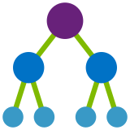
Azure Management Groups
1
Ensure compliance
2
Empower DevOps
Efficiently apply governance controls and manage groups of Azure subscriptions
3
Manage costs
1
`2
3
Fit your organization
Apply controls at scale
Simplify subscription management
Create a flexible hierarchy that can be updated quickly
Mirror the hierarchy to the organizational model that works for you
Scale up or down depending on the organizational needs
Leverage Azure Resource Manager (ARM) objects that integrate with other Azure services
Azure services:
Azure Policy
RBAC
Azure Cost Management
Azure Blueprints
Azure Security Center
Group subscriptions into logical groups
Inherit properties that apply to all subscriptions
View aggregated information above the subscription level

Slide 21

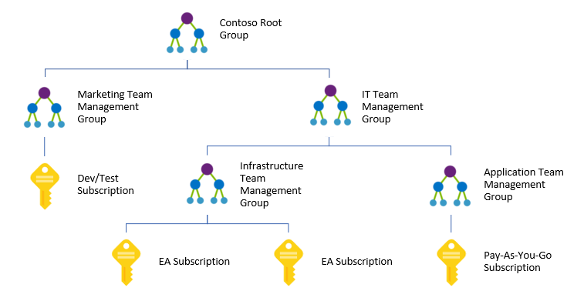
Management Groups to organize subscriptions
Create a custom management hierarchy to fit your organization
Enables RBAC, policies for tagging, cost analysis and budgets at any scope
Shared with Policy, Security Center, Privileged Identity Management services
Notes:
Role Base Access Control – grant authorization to perform certain admin tasks

Slide 22
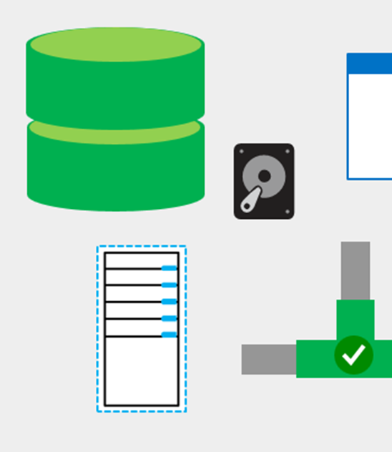
Resource groups
A collection of Azure Resources that you manage with a common lifecycle.
Notes:
You can think of your resource group as a container that allows you to aggregate and manage all the resources required for your application in a single manageable unit.

Slide 23
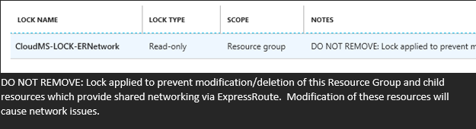
Resource Locks
2 types: ‘read only’ and ‘do not delete’
Acts as safety net – ‘are you sure ?’ button
Can be removed by subscription Owners
Notes:
Control plane vs Data plane – these guardrails exist at the control plane only – Azure Resource Manager (ARM) is the control plane.

Slide 24
Azure Policy
Active control and governance at scale for your Azure resources
Enforcement & compliance
Apply policies at scale
Remediate & automate
Turn on built-in policies or build custom ones for all resource types
Real-time policy evaluation and enforcement
Periodic & on-demand compliance evaluation
VM In-Guest Policy
Apply policies to a Management Group with control across your entire organization
Apply multiple policies and & aggregate policy states with policy initiatives
Exclusion Scope
Remediate existing resources at scale (NEW)
Automate remediation through runbooks, functions and logic apps
Trigger alerts when a resource is out of compliance

Slide 25

Azure Blueprints
1
Ensure compliance
2
Empower DevOps
Enabling quick, repeatable creation of fully governed environments
Manage costs
3
Streamline environment creation
Enable compliant development
Lock foundational resources
Centralize environment creation through templates
Add resources, policies and role access controls
Track blueprint updates through versioning
Empower developers to create fully governed environments through self-service
Create multiple dev-ready environments and subscriptions from a centralize location
Leverage the integration with Azure Policy on the DevOps lifecycle
Ensure foundational resources cannot be changed by subscription owners
Manage locks through a centralize location
Update locked resource through blueprint definition updates
Notes:
Allows you to deploy fully governed environments, and you can share or deploy blueprints with multiple subscriptions or management groups as needed, essentially giving you the ability to stamp out environments.
They can be managed from a central location and they have the ability to track versioning and even lock resources that you don’t want subscription owners to change.

Slide 26

Azure Resource Graph
1
Ensure compliance
2
Empower DevOps
Get visibility into your resources for effective inventory management
3
Manage costs
Explore your resources
Query & analyze
Assess impact
Get visibility into your Azure resources across subscriptions and management groups.
Access the information you need in the portal, CLI or PowerShell
Find assets based on resource properties or their relationships
Get the exact information you need through queries in seconds
Perform analysis at scale across all your environments
Leverage Keyword Query Language for easy query creation
Understand the impact of applying policies before their implementation
Get a view of the operational impact of common actions like deprecations
Notes:
Azure resource graph help you with inventory management and discoverability of the resources you have in Azure.
ARG takes a different approach, and caches all the information so you can get it in seconds.
You can use it on the portal or take advantage of powerful querying through poweshell by using KQL.

Slide 27
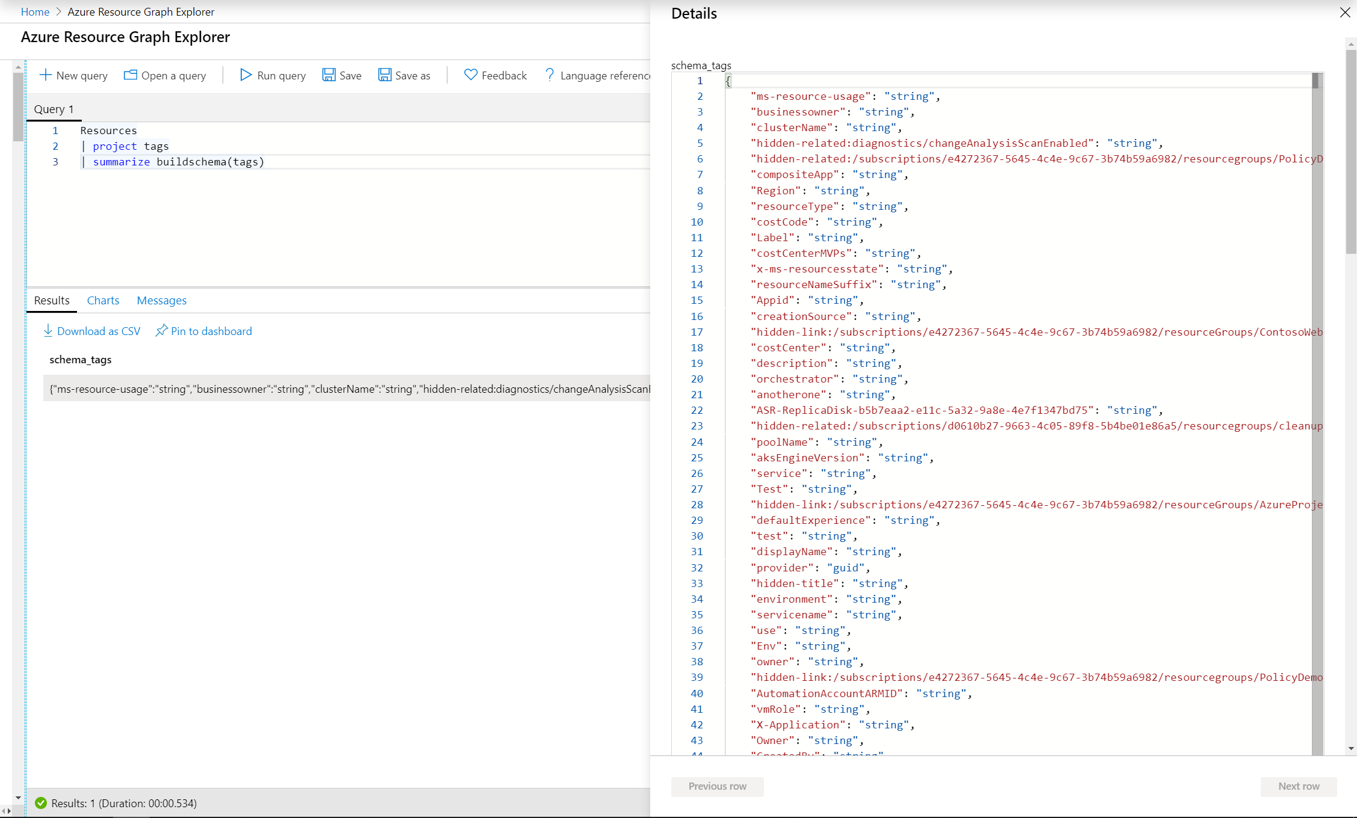
Tags
Tags for platform improvement
Key-value pairs that help you identify resources based on settings that are relevant to your organization
Manage tags with Policy
Automatically apply/inherit/replace/delete on new resources
Remediate existing resources in bulk
Query tags through Resource Graph
A resource group or subscription can contain many resources that each have 50 tag name-value pairs.
Use tags to group your billing data

Slide 28
Azure Cost Management
1
Ensure compliance
2
Empower DevOps
3
Manage costs
Monitor cloud spend
Drive organizational accountability
Optimize cloud efficiency
Track usage and cost trends
Detect spending anomalies and usage inefficiencies
Forecast future spend using your historical data
Visualize data in consolidated or custom dashboards
Allocate usage and costs to business units and projects
Produce chargeback and show back reports
Let teams access data and insights with Role-Based Access Control
Automatically alert stakeholders of spending anomalies and overspending risks
Increase resource utilization with virtual machine right-sizing
Eliminate idle resources
Improve virtual machine reserved instances management
Pay less for Windows Server and SQL Server resources through Azure Hybrid Benefit
Notes:
And lastly Cost management. On Sept 2017 we announced the acquisition of Cloudyn as Azure’s cost management service. Over this time we have learnt a lot from it and we have built a brand new cost management service from the ground up, which we call Azure Cost Management. It has improved performance compared to Cloudyn with <8hrs latency, better user experience and great integration with Azure services like tagging, management groups and action groups.
ACM allows you to monitor what you spend by doing cost analysis on easy to sue dashboards. You can create accountability across your teams by setting budgets, and you can optimize by taking advantage of Azure Advisor recommendations, Reserved Instacnes and Azure Hybrid Benefits

Slide 29
Question 3
What can be used to organize your subscriptions?
Notes:
Answers
Question 2: Hybrid cloud model provides the greatest degree of flexibility, as you have the option to choose either public or private depending on your requirements.

Slide 30
Question 4
What are some guardrails used in Azure?
Notes:
Answers
Management groups, Policy, Tagging, ARG, Blueprints

Slide 31
Question 5
What query language does Azure Resource Graph use ?
Notes:
Answers
KQL

Slide 32

Azure Storage types
Structured data
Adheres to a schema
Semi-structured data
Non-relational (NoSQL) data
Unstructured data
No restrictions, flat files
Holds PDFs, JPGs, JSON files, etc.
Notes:
Structured data. Data that adheres to a schema, so all of the data has the same fields or properties. Structured data can be stored in a database table with rows and columns. Examples of structured data include, sensor data or financial data.
Semi-structured data. Data is less organized than structured data, and is not stored in a relational format, meaning the fields do not neatly fit into tables, rows, and columns. Referred to as non-relational or NoSQL data.
Unstructured data. Data that has no designated structure to it. This also means that there are no restrictions on the kinds of data it can contain. For example, a blob can hold a PDF document, a JPG image, a JSON file, or video content.

Slide 33
Azure Storage
Disk Storage
Object Storage
File Storage
Ultra
Premium
Standard
Azure Blobs
(w/ Data Lake Gen 2)
Azure Files
Azure NetApp Files
Reliable, persistent, high performing storage for Virtual Machines
Secure, Scalable storage for unstructured data
Lift and shift applications that require file shares to the cloud
Data Transport
Hybrid Storage
Azure Data Box
Data Box Gateway/Edge
Azure File Sync
Avere
Move or migrate data into Azure
Secure, intelligent data tiering between on-premises and cloud
Notes:
backup

Slide 34
Azure Storage Durability (Replication Options)
Typically >300mi
Typically >300mi
Zone 2
Zone 1
Zone 2
Zone 3
Async
Async
Primary
Secondary
Primary
Secondary
Locally Redundant Storage
Replicates your data 3 times within the region of the storage account
Zone Redundant Storage
Replicates your data three times across two to three facilities, either within a single region or across two regions
Geo-Redundant Storage
Replicates your data to a secondary region that is hundreds of miles away from the primary region.
Read-Access-Geo-Redundant Storage
Replicates your data to a secondary region, as with GRS, but also then provides read-only access to the data in the secondary location.
Data can be read from primary and secondary locations
Notes:
Locally Rudundant Storage
Zone Redundant Storage
Geo-redundant storage

Slide 35

Azure Blob Tiers
Premium
Hot
Cool
Archive
Low and consistent latency data
Frequently accessed data
Less frequently accessed data
Rarely accessed data
PER TB PER MONTH
$150.00
$18.40
$10.00
$2.00
PER 10K READ OPERATIONS
$0.0014
$0.004
$0.01
$5.00
RETRIEVAL TIMES
Immediate (SSD)
Immediate (HDD)
Immediate (HDD)
Hours
Interactive
Transactions
Telemetry
Cloud native application data storage
Repository for server backups
Medical records archiving
USE CASE
EXAMPLES
Notes:
Ask customers to come talk afterwards if interested in cold storage tier with faster latency than Archive.
Blob-Level Tiering
Individual blobs can move between tiers
All tiers co-exist in the same storage account
Data Lifecycle Management
Automatic policy-based movement between tiers
Supports automatic deletion as well

Slide 36
Disks Storage | Overview
Standard HDD
Standard SSD
Premium SSD
Ultra SSD
Single disk value
Low-cost storage
Consistent performance
High performance
Sub-millisecond latency
Max Size
32 TiB
32 TiB
8X
32 TiB
64 TiB
Max IOPS
Up to 2,000
Up to 6,000
20,000
160,000
3-4X
Max BW
Up to 500 MBps
Up to 750 MBps
900 MBps
2,000 MBps

Slide 37
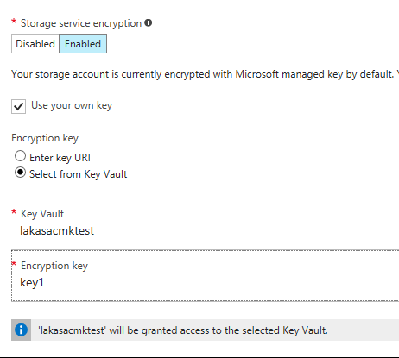
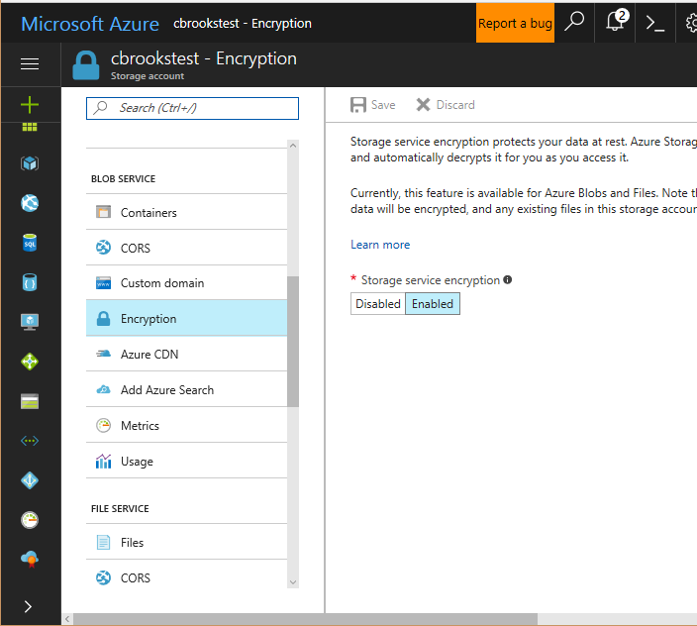
Encryption At Rest – Storage Service Encryption
Prevents data disclosure from physical disk compromise
Available for Blobs with MS managed keys
Encryption enabled for all accounts
Customer managed encryption keys
Notes:
https://azure.microsoft.com/en-us/blog/announcing-larger-higher-scale-storage-accounts/
https://docs.microsoft.com/en-us/azure/storage/common/storage-service-encryption-customer-managed-keys

Slide 38
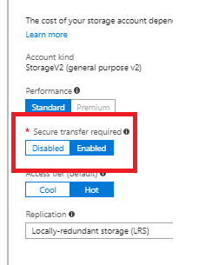
Encryption In Transit
Storage REST APIs support HTTPS
SAS Tokens can be restricted for HTTPS only
“Secure Transfer” option
Limit all access to HTTPS only
Enables control via ARM Policy and monitoring via Microsoft Defender for Cloud

Slide 39



DDoS Protection
Azure WAF
Azure Firewall
Azure Firewall Manager
Network Security Groups
Service Endpoints/Private Link
Virtual Network
Virtual WAN
ExpressRoute
VPN
DNS
Azure networking services
Azure Updates
Azure Blog
Microsoft Learn
Azure Pricing
CDN
Front Door
Traffic Manager
Application Gateway
Load Balancer
Network Watcher
ExpressRoute Monitor
Azure Monitor
Virtual Network TAP
Notes:
Microsoft Learn

Slide 40


Azure Network Security Cloud native services to help secure cloud perimeter
Segment
Protect
Connect
Prevent lateral movement and data exfiltration
Secure network
with threat
intelligence
Embrace
distributed connectivity
Deploy securely across DevOps process

Slide 41




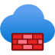
Network Segmentation
Subscription
Virtual Network
Network Security Group
Web Application Firewall
Azure Firewall
A logical isolation of environment for all resources
An isolated and highly secure environment to run your virtual machines and applications
Enforce and control network traffic security rules that allow or deny network traffic for a VNet or VM
Define application specific network security policies to protect web workloads
Create and enforce connectivity policies using application, network and threat intelligence filtering across subscription, VNet

Slide 42





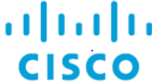






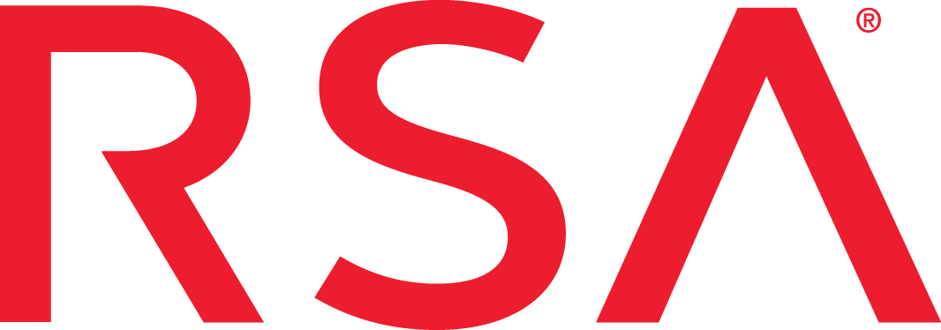

Achieving Zero Trust with Azure Networking
Cloud-Native Network Security Services
Azure
Firewall
Azure Web
Application Firewall
Azure
PrivateLink
Azure DDoS
Protection
Software Defined Network (SDN)
Virtual
Networks
Network
Security Groups
User Defined
Routes
Load Balancer
Defense-in-Depth
+
Networking Partner Solutions
Notes:
The principles of Zero Trust are:
Verify explicitly
Consider every data point before authenticating someone’s access, including their identity, location, and device, as well as how the resource is classified and if there’s anything unusual that might be a red flag.
Use least privileged access
Limit the amount of information and length of time people can access something, instead of providing access to all company resources indefinitely.
Assume breach
Segment networks so if someone does get unauthorized access, the damage is contained. Require end-to-end encryption.

Slide 43
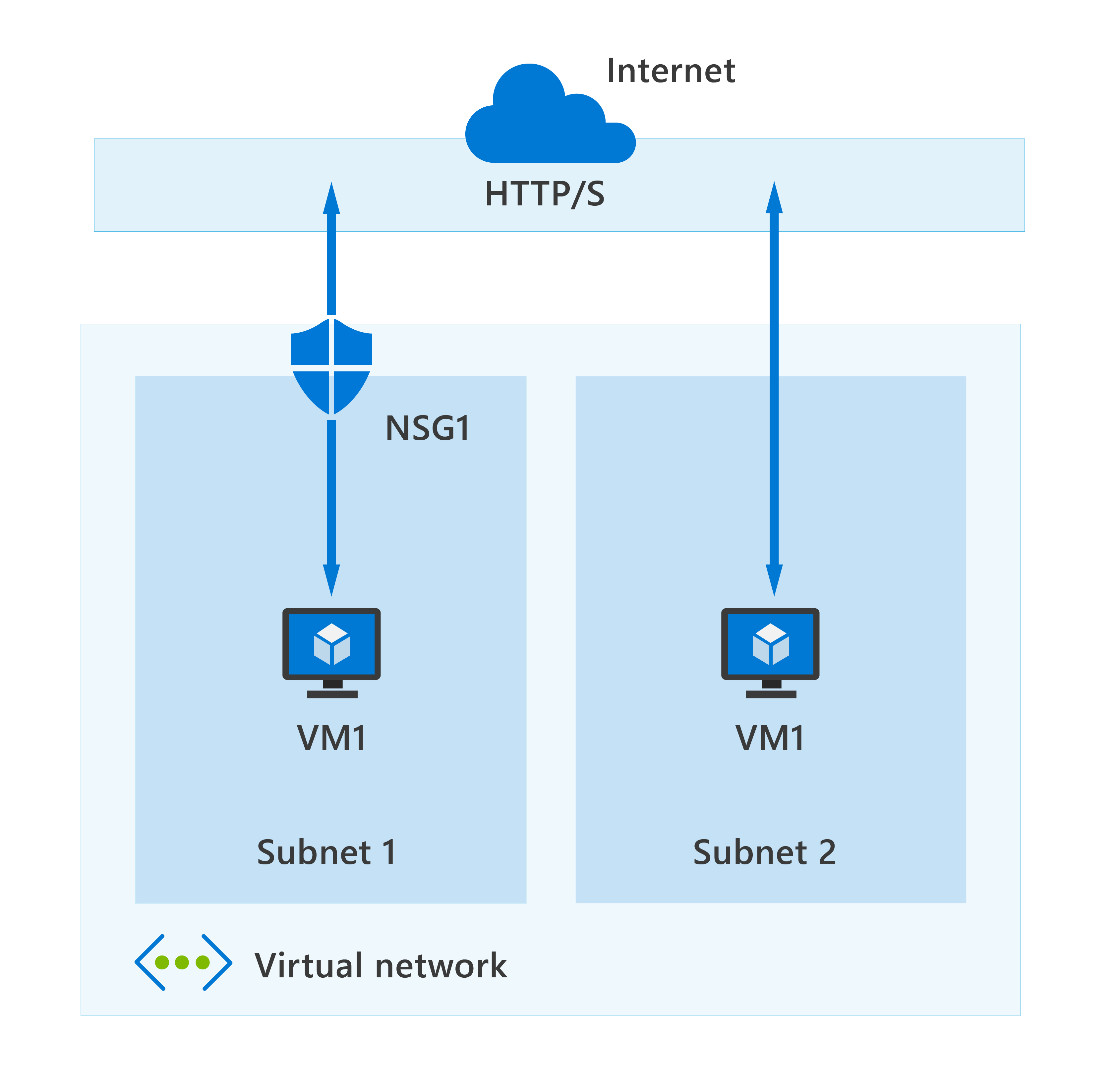
Azure Network Security Groups(NSG)
Azure network security groups can automatically allow or deny traffic
Contains security rules
NSG security rules are evaluated by priority using five information points

Slide 44

Introduction to service endpoints
Virtual Network (VNet) service endpoints extend
your virtual network private address space and
the identity of your VNet to the Azure services, over a direct connection
Endpoints allow you to secure your critical Azure service resources to only your virtual networks
Endpoints use the Microsoft Azure backbone network

Slide 45
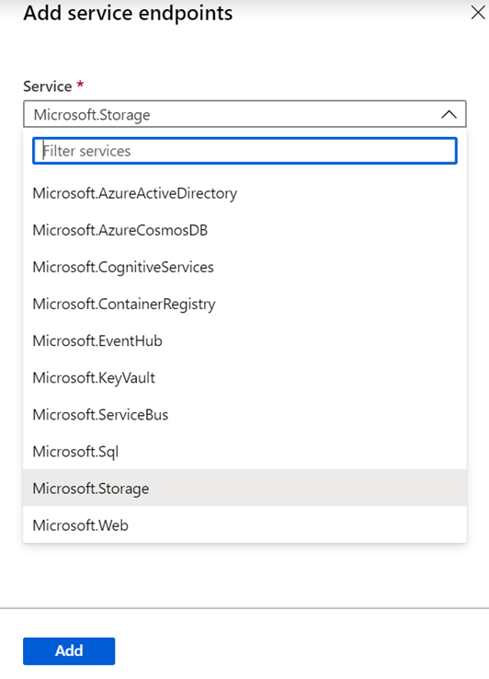
Service endpoint | Services
There are many types of service endpoints
Azure storage
Azure SQL database
Azure Synapse Analytics
Azure Database for PostgreSQL server
Azure database for MySQL server
Azure Database for MariaDB
Azure CosmosDB
Azure Key Vault
Azure Service Bus
Azure Event Hubs
Azure Data Lake store Gen 1
Azure App Service
Azure Cognitive Services
Azure Container Registry (Public Preview)
Adding service endpoints can take up to 15 minutes to complete

Slide 46
Routing network traffic
Azure routes traffic between subnets, connected virtual networks, on-premises networks, and the Internet, by default
You can implement either or both of the following options to override the default routes Azure creates
Route tables
Border gateway protocol (BGP) routes

Slide 47
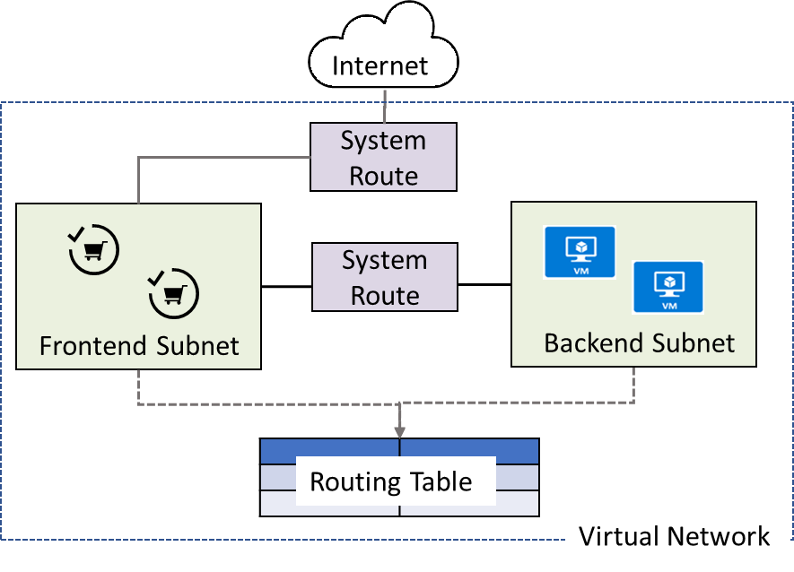
System Routes
System routes direct network traffic between virtual machines, on-premises networks, and the Internet:
Traffic between VMs in the same subnet
Between VMs in different subnets in the same virtual network
Data flow from VMs to the Internet
Communication between VMs using a VNet-to-VNet VPN
Site-to-Site and ExpressRoute communication through the VPN gateway

Slide 48
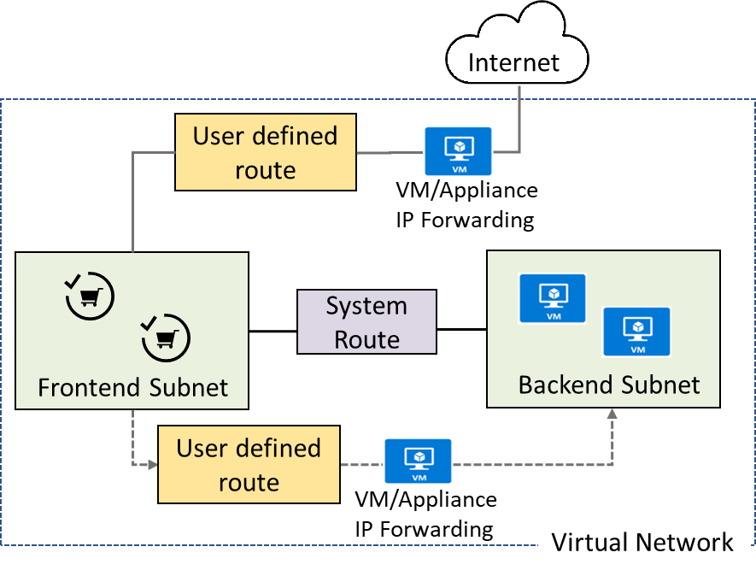
User Defined Routes
A route table contains a set of rules, called routes, that specifies how packets should be routed in a virtual network
User-defined routes are custom routes that control network traffic by defining routes that specify the next hop of the traffic flow
The next hop can be a virtual network gateway, virtual network, internet, or virtual appliance

Slide 49



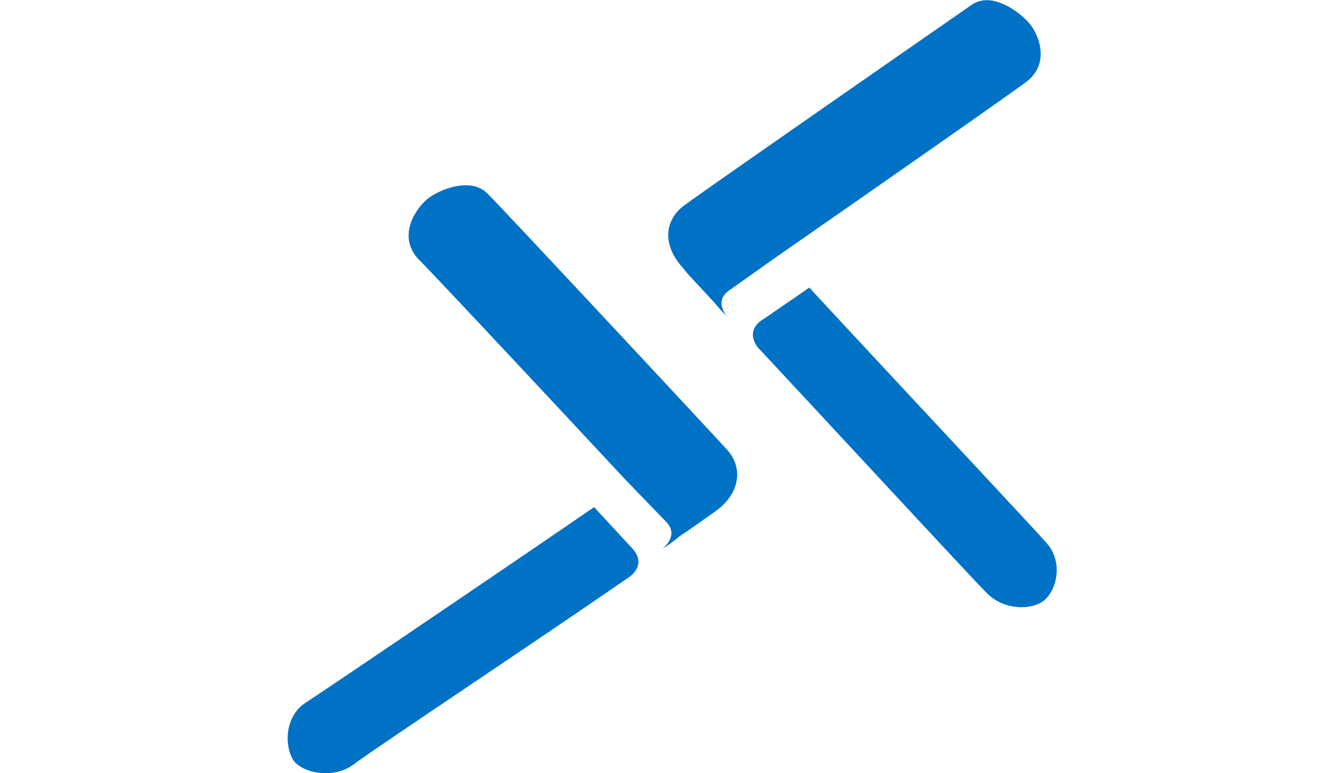
Azure Bastion
Secure and seamless RDP and SSH access to your virtual machines using zero trust
RDP/SSH to your workload using HTML5 standards-based web-browser, directly in Azure Portal
Customer’s Virtual Network
Private IP
Port: 3389/22
“AzureBastionSubnet”
Azure VM
Resources can be accessed without public IP addresses
SSL
Remote Protocol
(RDP, SSH, et al)
Azure VM
Azure Portal
Supported Azure resources include VMs, VM Scale Sets, Dev-Test Labs
SSL
443, Internet
Azure VM
Azure Bastion
AzureBastionSubnet
Target VM Subnet(s)
No agent required

Slide 50
Availability
Availability is a key component of any security program
If your users and systems can't access what they need to access over the network, the service can be considered compromised
Azure has networking technologies that support the following high-availability mechanisms
HTTP-based load balancing
Network level load balancing
Global load balancing

Slide 51
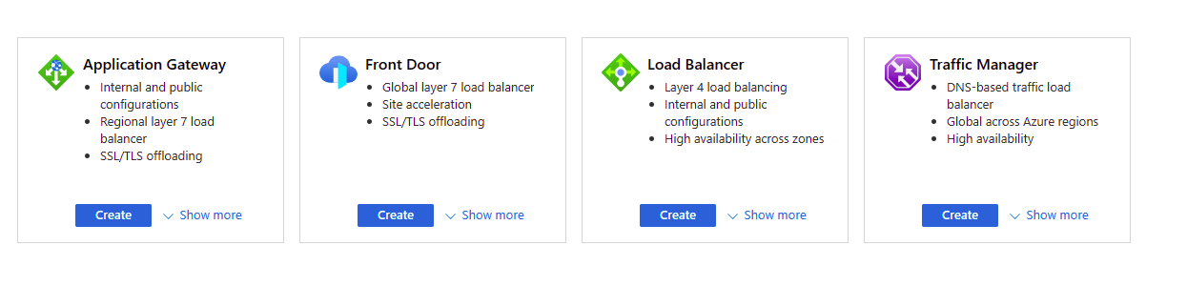
Load balancing options for Azure
What is the right option for your customer?
It depends.
Notes:
OSI Layer
Physical
Data link
Network
Transport (4th layer)
Session
Presentation
Application ((7th layer)

Slide 52
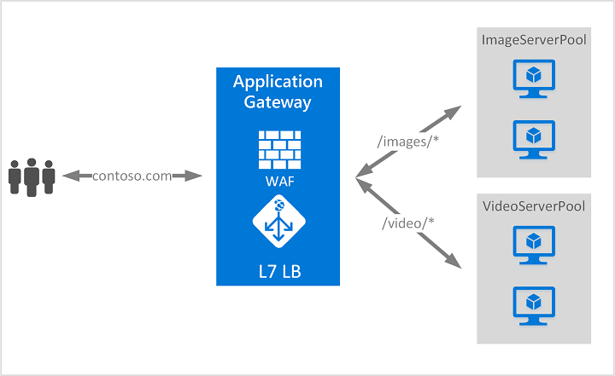
HTTP-based load balancing
HTTP-based load balancing supports
Cookie-based session affinity
TLS offload
URL-based content routing

Slide 53
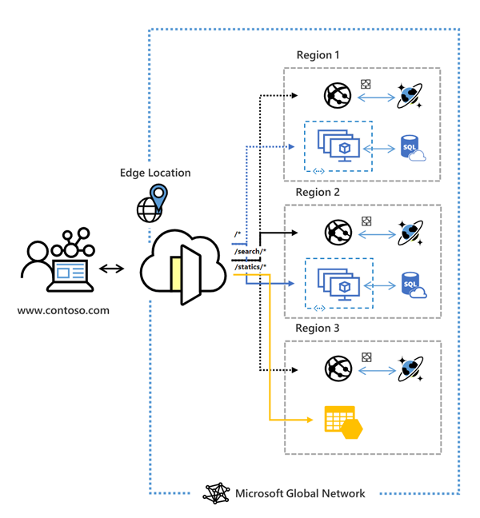
Introduction to Azure Front Door
Global, scalable entry-point that uses the Microsoft global edge network to create fast, secure, and widely scalable web applications
Accelerated application performance by using split TCP-based anycast protocol
Intelligent health probe monitoring for backend resources
URL-path based routing for requests
Enables hosting of multiple websites for efficient application infrastructure
Azure Front Door | Microsoft Docs

Slide 54
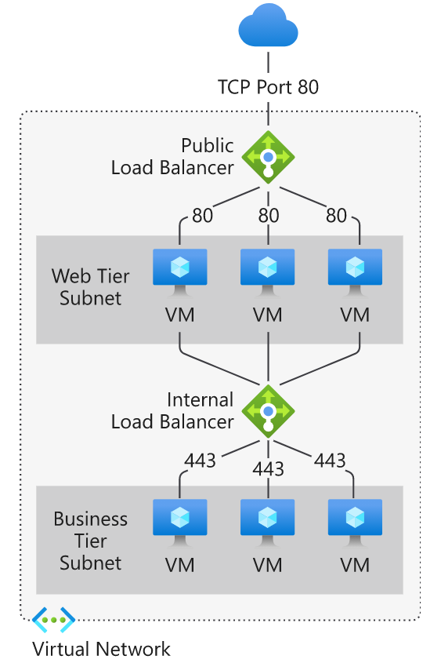
Network level load balancing
In contrast to HTTP-based load balancing, network level load balancing makes decisions based on IP address and port (TCP or UDP) numbers
You can gain the benefits of network level load balancing in Azure by using Azure Load Balancer

Slide 55

Azure Traffic manager
A DNS-based traffic load balancer enables you to distribute traffic optimally to services across global Azure regions, while providing high availability and responsiveness

Slide 56
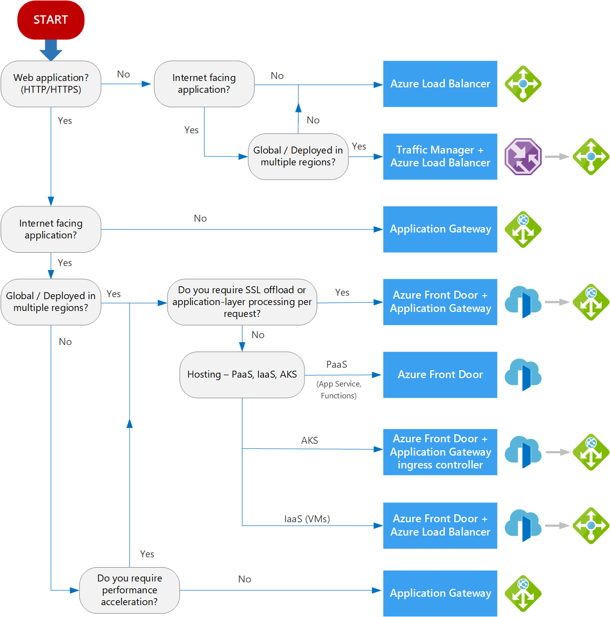
Choosing a load balancing option
Type of traffic
Type of traffic
Scope
Scope
Availability
Availability
Cost
Cost
Features and limitations

Slide 57
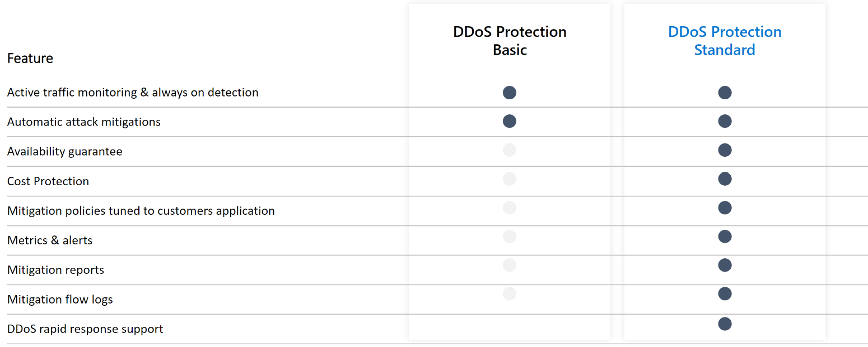
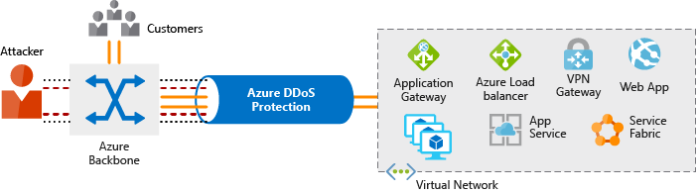
Azure DDoS protection
The Azure DDoS Protection service is designed to help protect your applications and servers
Azure DDoS Protection tiers
Basic
Standard
Azure DDoS Protection Standard Overview | Microsoft Docs

Slide 58
Securing remote access and cross-premises connectivity

Slide 59
Securing remote access | Scenarios
Azure networking supports the following secure remote access scenarios
Connect individual workstations to a virtual network
Connect your on-premises network to a virtual network with a VPN
Connect your on-premises network to a virtual network with a dedicated WAN link
Connect virtual networks to each other

Slide 60
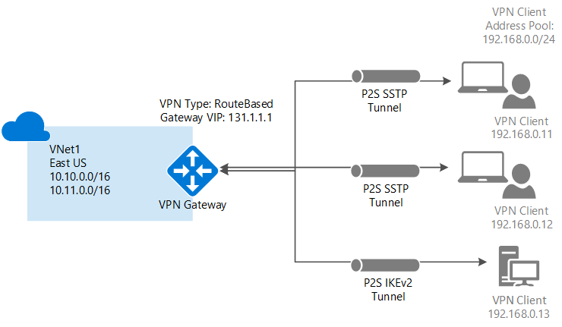
Connect individual workstations to a virtual network Point-to-site virtual private network (VPN)
A Point-to-Site (P2S) VPN gateway connection lets you create a secure connection to your virtual network from an individual client computer
Point-to-site VPN supports
Secure Socket Tunneling Protocol (SSTP)
IKEv2 VPN
OpenVPN

Slide 61
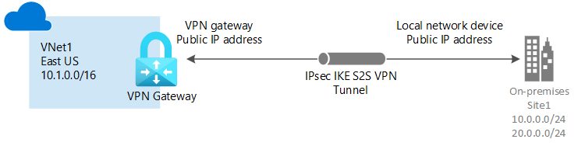
Connecting your on-premises network to a virtual network using Site-to-Site VPN
A site-to-site VPN connects an entire network (such as your on-premises network) to a virtual network
Site-to-site VPNs to a virtual network use the highly secure IPsec tunnel mode VPN protocol

Slide 62
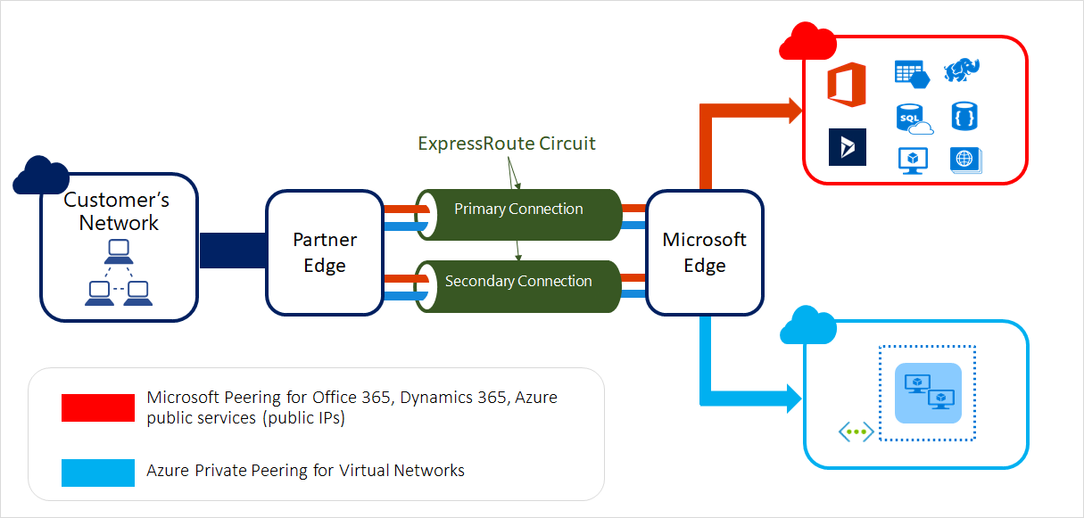
Connecting your on-premises network to a virtual network with a dedicated WAN link
Organizations that need the highest level of security and availability use dedicated WAN links to connect to remote sites
Azure provides this ability with
Azure ExpressRoute
Express route direct
Express route global reach

Slide 63
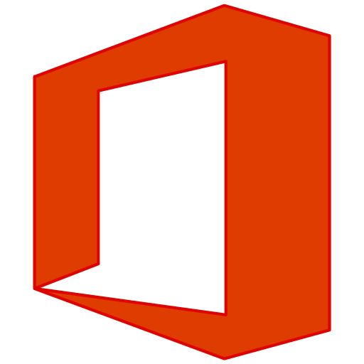



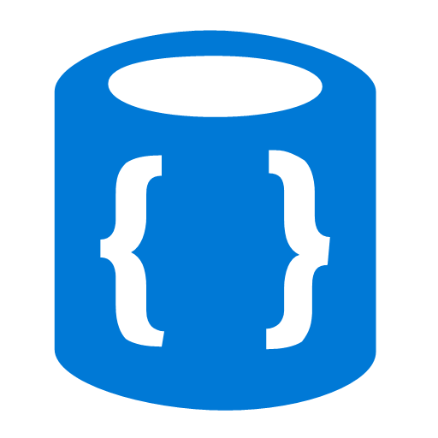




ExpressRoute
✔ Unified connectivity to Microsoft Cloud Services
✔ Predictable performance
✔ Enterprise-grade resiliency and with SLA for availability
✔ Large and growing ExpressRoute partner ecosystem
Customer’s Network
Partner Edge
Primary Connection
Microsoft Edge
Secondary Connection
ExpressRoute Circuit
Microsoft Peering for Office 365, Dynamics 365, Azure public services (public IPs)
Azure Private Peering for Virtual Networks

Slide 64
Connect virtual networks to each other through VNet Peering
Virtual network peering enables you to seamlessly connect two or more Virtual Networks in Azure
Azure supports the following types of peering
Regional Virtual network peering
Global virtual network peering

Slide 65



Azure Firewall Cloud native stateful Firewall as a service
A first among public cloud providers
Central governance of all traffic flows
Built-in high availability and auto scale
Network and application traffic filtering
Centralized policy across VNets and subscriptions
Complete VNET protection
Filter Outbound, Inbound, Spoke-Spoke and Hybrid Connections traffic (VPN and ExpressRoute)
Centralized logging
Archive logs to a storage account, stream events to your Event Hub, or send them to Log Analytics or Security Integration and Event Management (SIEM) system of choice
Best for Azure
DevOps integration, integration with Sentinel and ASC, FQDN Tags, Service Tags, Integration with ASE, Backup and other Azure services
User configuration
L3-L7 connectivity policies
Microsoft Threat Intelligence
Known malicious IPs and FQDNs
Spoke 1
Central VNet
Threat intel, NAT, network and application traffic filtering rules allows inbound/ outbound access
Spoke 2
Azure Firewall
Traffic is denied by default
Azure to on-prem traffic filtering
Spoke VNets
On-premises
Notes:
Southbound traffic is data entering the data center (through a firewall and/or other networking infrastructure). Data exiting the data center is northbound traffic, commonly routed through a firewall^{[1]} to Internet space.

Slide 66
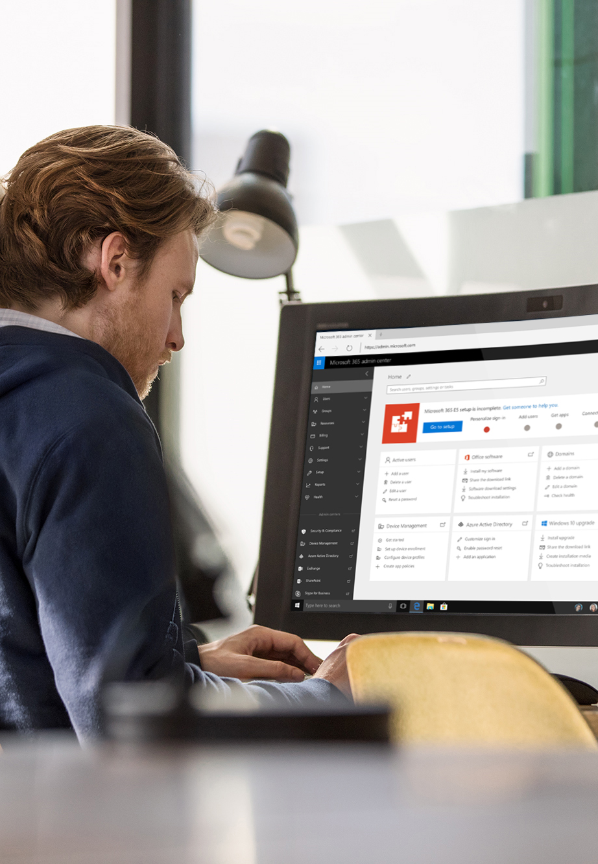
Azure Firewall Key features
Application rules
FQDN Filtering (HTTP/S, MSSQL)
FQDN Tags (e.g., Windows Update, Azure Backup, ASE,HDI)
Default infrastructure rule collection
Fully stateful network rules
Service Tags
NAT support
Default Source Network Address Translation (SNAT)
Destination Network Address Translation (DNAT)
Threat Intel
Deny and Alert on known malicious IPs and domains
Monitoring
Azure monitor logging
Azure monitor metrics
Network watcher
Scale and availability
Built-in auto scale (30 Gbps) and HA
Multiple public IPs – up to 250
Availability Zones (99.99% SLA)
Recently released
GA: FQDN filtering in network rules (all ports and protocols)
GA: Custom DNS and DNS Proxy
GA: Web Categories (based on FQDN)
GA: Premium SKU

Slide 67
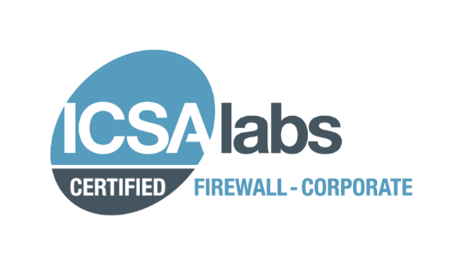
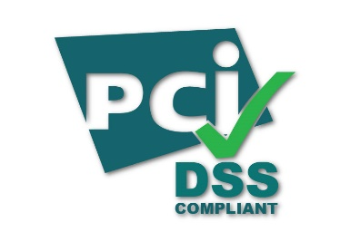




Azure Firewall Premium Cloud native Next-Gen Firewall as a service
TLS Inspection
Built-in TLS Inspection for Outbound and East-West traffic
Inbound TLS termination is supported with Azure Application Gateway
Customer provided key pair via Azure Key Vault integration
Intrusion Detection Prevention System (IDPS)
Detect alert and block inbound/outbound malicious traffic
Supported for both encrypted and plain text protocols
Signature-based detection that is continuously updated
URL Filtering
Restrict user access to HTTP/HTTPS Web content
Support for URL wildcards
Web Categories
Allow or deny user access to website categories such as gambling, social media and others
Web categories maintained and continuously updated
URL based category matching
Azure Firewall Standard
Including all standard firewall capabilities
URL
Filtering
IDPS
TLS
Inspection
Web
Categories
Spoke 1
Azure Firewall Premium
Spoke 2
Azure Firewall
Traffic is denied by default
Internet
Central VNet
Spoke VNets
Azure to on-prem traffic filtering
On-premises

Slide 68


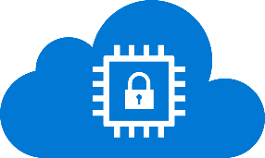








Azure Security Services
Protect Azure and your entire multi-cloud environment with built-in security.
Identity and Access Management
Threat Protection
Apps & Data Security
Network Security
Azure Active Directory
Your universal platform to manage and secure identities
Microsoft Sentinel (SIEM/SOAR)
Intelligent security analytics for your entire enterprise
Azure Confidential Computing
Protect your data and code while in use in the cloud
Azure Firewall
Cloud-native firewall to protect Azure virtual networks
Microsoft Defender for Cloud
Built-in threat protection for your hybrid cloud workloads
Azure Firewall Manager
Central network security policy management
Security Posture Management
Azure Key Vault
Safeguard cryptographic keys and other secrets
Azure Web Application Firewall
Protect web/mobile apps and APIs from common web vulnerabilities
Microsoft Defender for Cloud
Security posture management for your hybrid cloud workloads
Azure Defender for IoT
Agentless asset discovery, vulnerability management, and threat detection for IoT/OT devices
Azure Attestation
Safeguard cryptographic keys and other secrets
Azure Front Door
Fast, reliable and secure cloud CDN with threat protection
Azure Dedicated HSM
Your hardware security module (HSM) in the cloud
Azure DDoS Protection
Always-on monitoring to protect against DDoS attacks
Azure Bastion
Private and fully managed RDP and SSH access to your VMs
Notes:
SIEM Secure information and event management system
Security Orchestration Automation and Response

Slide 69
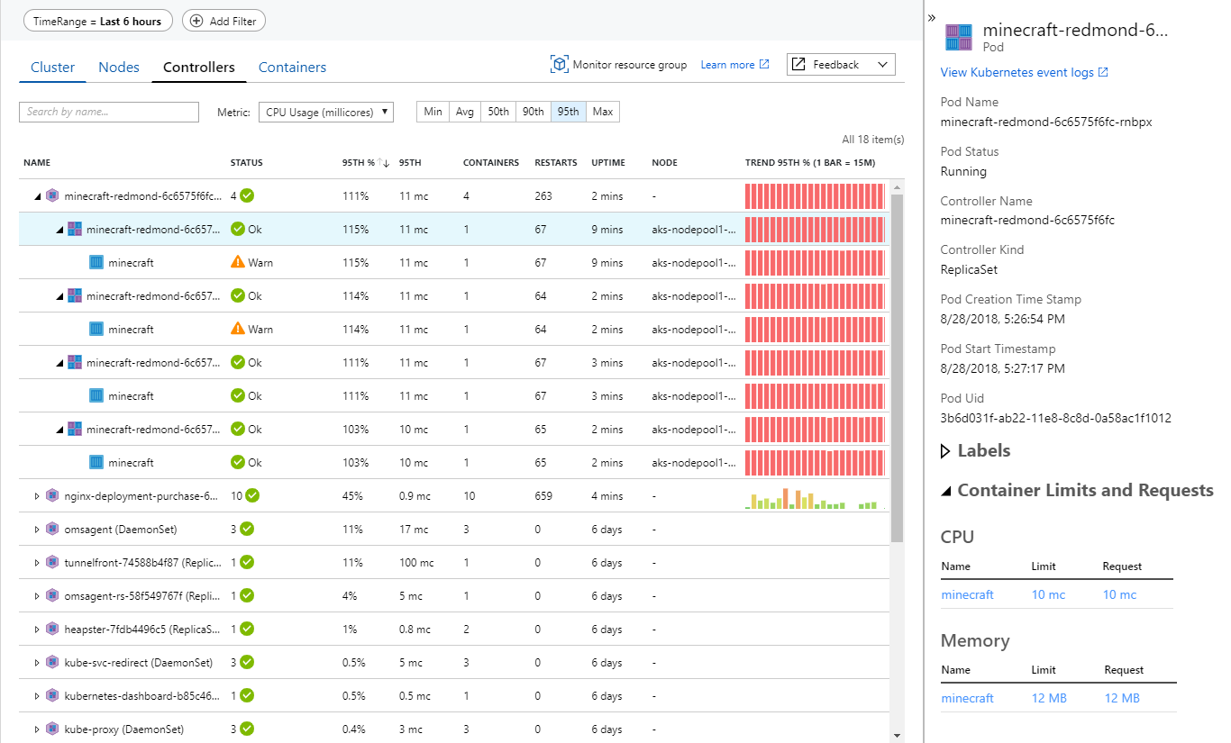
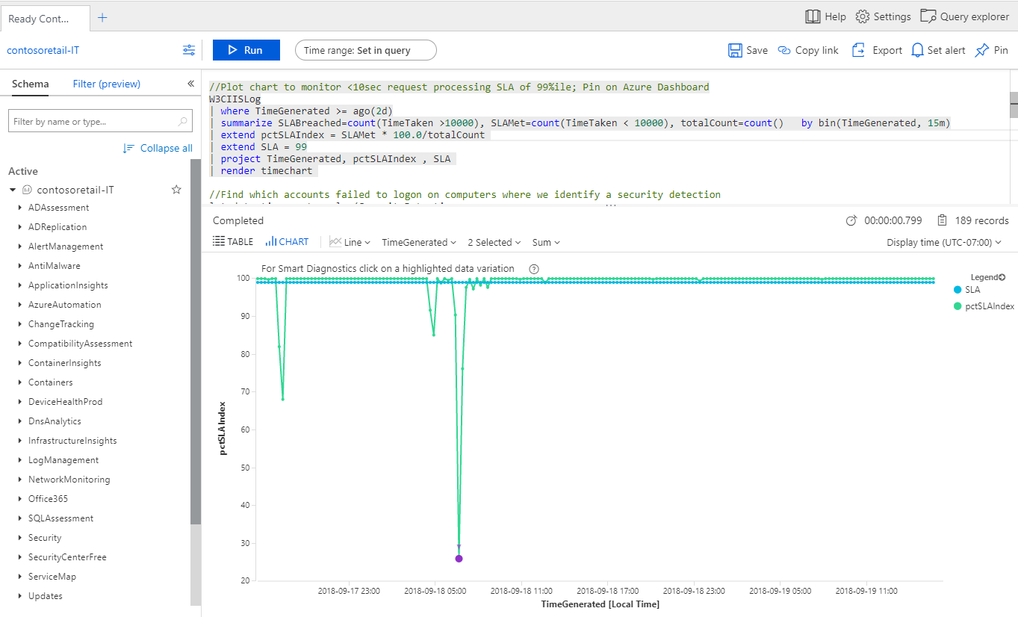
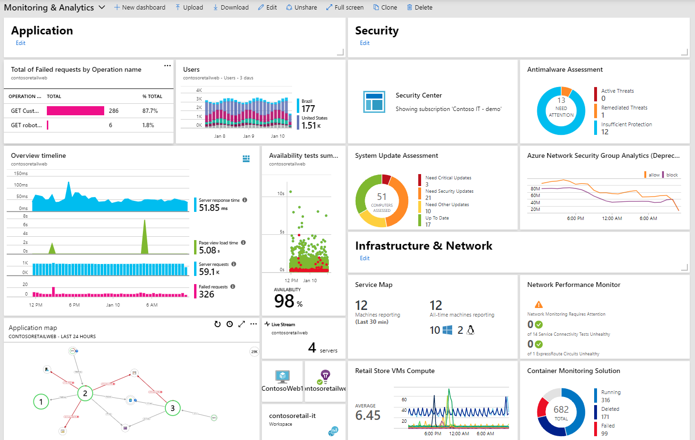
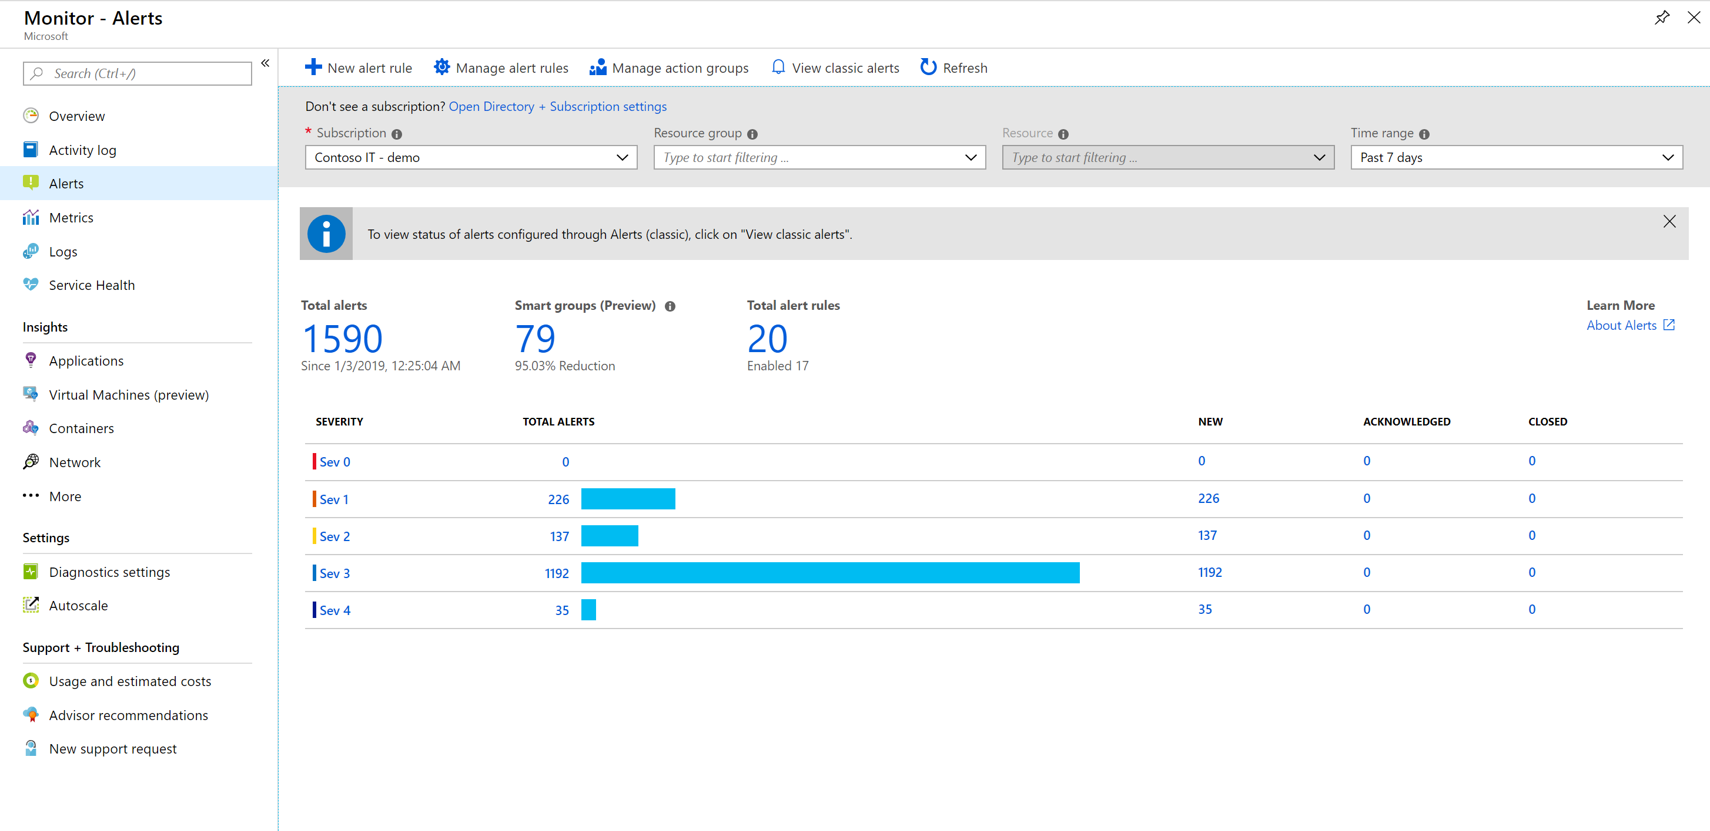
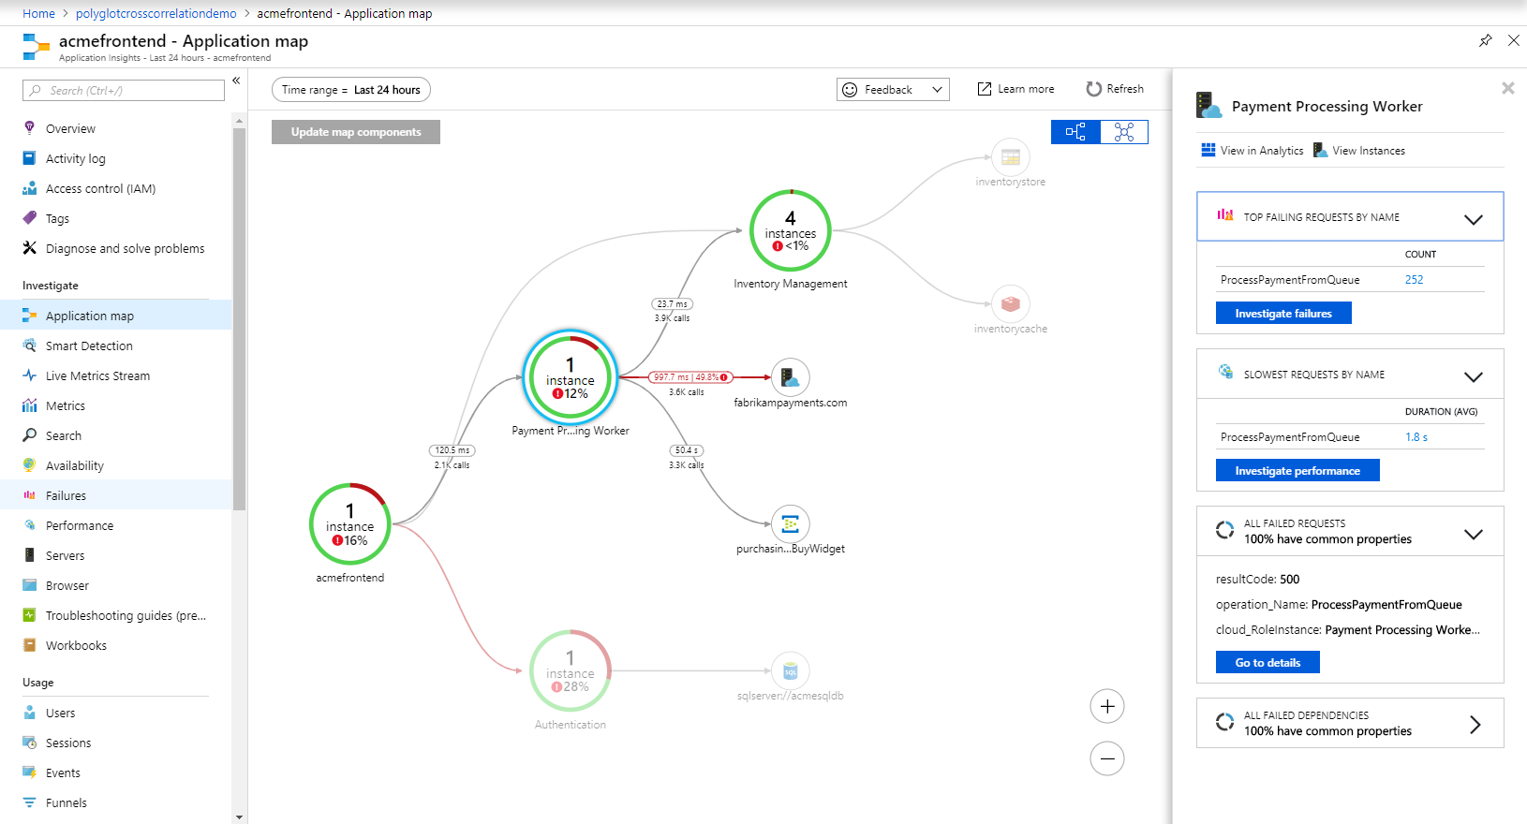
Azure Monitor : Observability Scenarios
Detect & diagnose issues across apps and dependencies with application insights
Correlate issues at infra level with insights for VMs, containers, SQL, network, etc.
Operationalize at scale with smart alerts and automated actions
Drill down with log analytics for troubleshooting & deeper diagnostics
Create visualizations with Azure dashboards, workbooks & Grafana

Slide 70

Ensure business continuity to avoid disruption
Azure Site Recovery + Azure Backup + Partner Solutions
One-click backup for VMs and databases
Protect from ransomware and human errors
Recover data and apps quickly and reliably
Up to 47% cost savings in infrastructure*
High Availability
High Availability
SLA 99.9% Isolated VM failure
SLA 99.95% Hardware failure
SLA 99.9%
Entire datacenter failure
Minimal RPO/RTO
Entire region failure
* IDC study sponsored by Microsoft estimates that customers will save on hardware and software costs of up to 47% in 5 years. The study compares Azure Site Recovery and Azure Backup with an on-premises backup and disaster recovery solution.
Notes:
Azure offers built-in backup and disaster recovery services that are easy to deploy, cost-effective, secure, and scalable, providing you with an end-to-end business continuity solution.
In the case of a disruption, whether it’s ransomware, data deletion or corruption due to human errors or outages, you can recover your apps and data in a timely and reliable manner.
An IDC study showed that compared to on-premises backup and disaster recovery solutions, customers that used Azure Backup and Azure Site Recovery achieved significant improvement in business operations, with an estimated 337% ROI in 5 years.
With Azure, customers can also enjoy high availability. From a single virtual machine to a datacenter to an entire region, we have guaranteed SLAs and industry leading RPO (Recovery Point Objective) and RTO (Recovery Time Objective). In fact, the average Azure VM uptime was 99.998% rolling 12 months to April 2020.
Additional notes:
Azure provides built-in solutions for customers to implement simple, secure and cost-effective Business Continuity and Disaster Recovery (BCDR) strategies for their applications and data. Once enabled, customers benefit from minimal maintenance and monitoring overhead, remote management capabilities, enhanced security, and the ability to immutably recover business services in a timely and orchestrated manner. Customers can also use the preferred backup provider of choice and take advantage of built in Azure integrations to extend their on-premises BCDR solutions to Azure. All of this is possible without the need to learn new tools for configuration or management.
Azure Backup is designed specifically to back up and restore data, and Azure Site Recovery is designed to perform seamless application disaster recovery. Together, these services provide an end-to-end solution that can be implemented and scaled with just a few clicks.
By not having to build on-premises solutions or maintain a costly secondary datacenter, users can reduce the cost of deploying, monitoring, patching, and scaling disaster recovery infrastructure. Azure Backup automatically allocates and manages backup storage with flexible policies to optimize cost and meet business objectives. Users can add or remove managed resources through the Azure portal as storage needs fluctuate over time. Together, Azure Backup and Azure Site Recovery use the underlying power and unlimited scale of the cloud to deliver high availability with minimal maintenance or monitoring overhead. These native capabilities are available through a pay-as-you-use model that bills only for the storage that is consumed.
For further simplicity, Azure’s centralized management interface for Azure Backup and Azure Site Recovery makes it simple to define policies to natively protect, monitor, and manage a wide range of enterprise workloads including Azure Virtual Machines, SQL and SAP databases, on-premises Windows servers and VMware machines. Using Azure Site Recovery, users can set up and manage replication, failover, and failback from a single location in the Azure portal. The Azure hybrid services tool in Windows Admin Center can also be used as a centralized hub to easily discover all the available Azure services that bring value to on-premises or hybrid environments. Windows Admin Center streamlines setup and the process of replicating virtual machines on Hyper-V servers or clusters, making it easier to bolster the resiliency of environments with Azure Site Recovery's disaster recovery service.
Azure is committed to providing the best-in-class data protection to keep your applications running. Azure Backup protects backups of on-premises and cloud-resources from ransomware attacks by isolating backup data from source data, combined with multi-factor authentication and the ability to recover maliciously or accidentally deleted backup data. With Azure Site Recovery you can fail over VMs to the cloud or between cloud data centers and secure them with network security groups.
Peace of mind is paramount when it comes to recovering from the unexpected. In the case of a disruption, accidental deletion, or corruption of data, customers can be rest assured that they will be able to recover their business services and data in a timely and orchestrated manner. These native capabilities support low recovery-point objective (RPO) and recovery-time objective (RTO) targets for any mission-critical workload in your organization. Azure is here to help customers pivot towards a strengthened BCDR strategy.

Slide 71
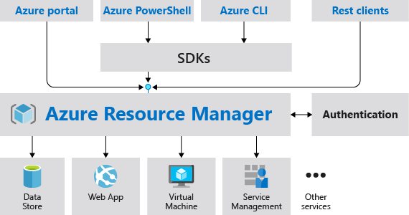
Azure management tools
Azure Portal
Web portal (exam: choose for creation from mobile phone)
Azure PowerShell
Client-based shell based on Windows (.NET), Linux, or MacOS (.NET Core)
Azure CLI
CLI for Windows, Linux, and MacOS
Bash on Windows Subsystem for Linux
Azure Cloud Shell
Browser-based environment for PowerShell & Bash CLI
Notes:
Azure Portal. A website accessed via a web browser at
Azure PowerShell. A command shell scripting language
Azure Command-Line Interface (Azure CLI). A cross-platform command-line scripting program for Windows, Linux, or MacOS operating systems
Azure Cloud Shell. A browser-based scripting environment in your portal.
Azure Resource Manager is a management layer in which resource groups and all the resources within it are created, configured, managed, and deleted
With Azure Resource Manager, you can:
Deploy application resources
Organize resources
Control access and resources

Slide 72
Azure Advisor provides optimization recommendations
Cost
High Availability
Security
Performance
Maximize the return of your IT budget investment
Improve the availability of your business-critical applications
Enhance protection of your Azure resources from potential security threats
Optimize performance to make the most of your resources
Resource recommendations (right-sizing, idle, etc.)
Purchasing recommendations (reserved instances, etc.)

Slide 73
Thank You

